Slide 1
Michael R Nelson MNELSON@POBOX.COM
Senior Researcher
Transparency and Strategic Leaking
Notes:
Businesses have always faced conflicting demands for information openness and sharing vs. information security and privacy
But the general trend toward more openness is unstoppable, as information becomes a dominant business driver, and as individuals, firms and governments are all expected to be more transparent
While the risks of more transparency are well understood, many firms have not systematically thought through the potential benefits in areas such as R&D, product development, sales, marketing, and recruitment
Thus, every firm has an implicit transparency strategy, but relatively few have an explicit one. Explicit discussions are needed to overcome legitimate security concerns, and the bias toward “worst case” thinking
Developing an effective transparency strategy requires CXO commitment, as well as IT, legal, marketing, and HR support.
Strategies will vary widely by company, industry, and geography, but every firms faces basic questions of internal and external positioning
While this issue in its very early stages, the LEF has developed a number of models to help firms think through the many issues involved

Slide 2
The Most Important Thing I learned in DC

Slide 3
The Most Important Thing I learned in DC
ALWAYS have a good bumper sticker

Slide 4
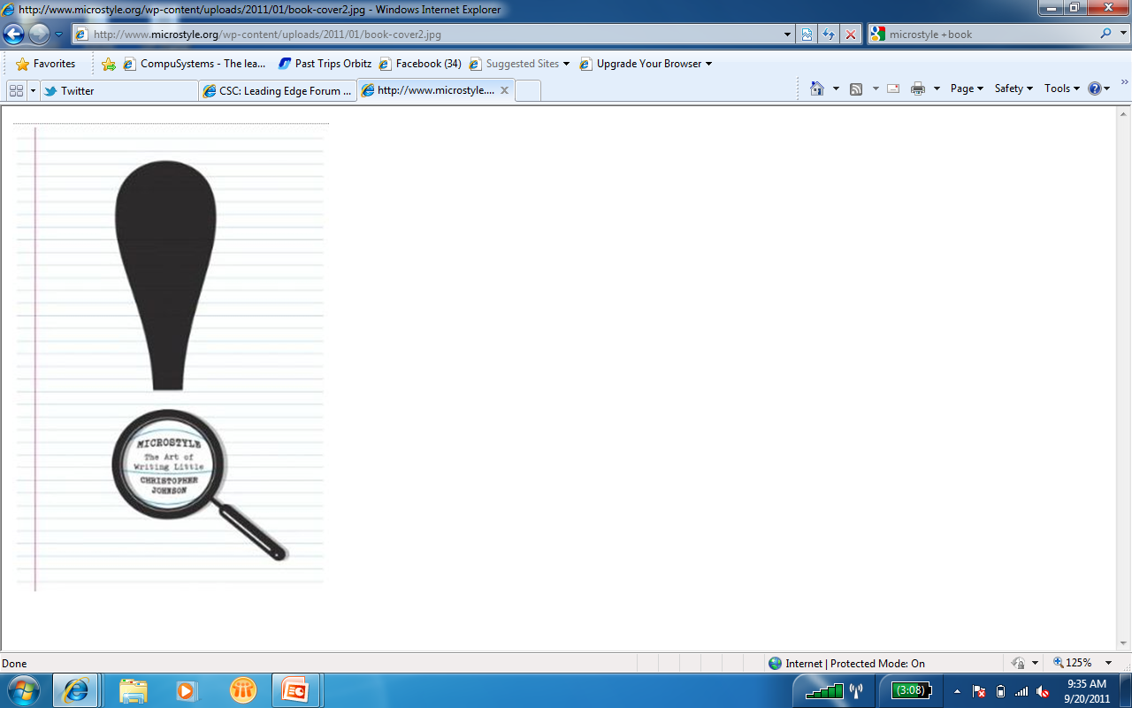
A Quick Book Review
Microstyle – The Art of Writing Little
by Christopher Johnson

Slide 5
Today’s Bumper Stickers
You’re going to have to be more transparent (whether you want to or not)

Slide 6
Today’s Bumper Stickers
You’re going to have to be more transparent (whether you want to or not)
You need a transparency strategy

Slide 7
Today’s Bumper Stickers
You’re going to have to be more transparent (whether you want to or not)
You need a transparency strategy
This isn’t just about tools and technology; It’s about culture and leadership

Slide 8
Information management – what’s changed?
100
10
1
Data
Sharing
Control
1990 2000 2010

Slide 9

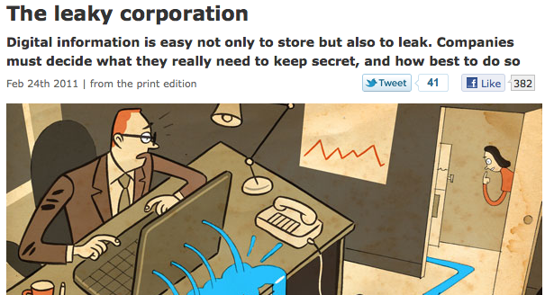
The Economist on transparency

Slide 10
Driving Cultural Change from the Outside In
External
Legalistic
Collaborative
Licensing
Non-disclosure
Compliance
Open Innovation
Speed and agility
Publicity/reputation
Secrecy
Transparency

Slide 11
Driving Cultural Change from the Outside In
External
Legalistic
Collaborative
Licensing
Non-disclosure
Compliance
Open Innovation
Speed and agility
Publicity/reputation
Secrecy
Transparency
Locked-down
Learning
Hierarchies
Silos
Need-to-know culture
Flat organizations
Information sharing
Participatory culture
Internal

Slide 12
Major areas of potential transparency
Thoughts and opinions of the CEO and key employees
Research and product plans (even source code and other IP; open science)
Personnel data (bios, contact information, job focus, even salaries)
Sales goals and figures
Customer data (anonymized)
Customer complaints and resolutions
Pricing and purchasing data
Everyday operations -- schedules, events, webcasts
Crisis response
External
Internal
Low
Transparency
High

Slide 13
Trust and transparency
Trust tension
(Customers)
(Vendors)
Privacy Identity
0% Amount of Disclosure of PII 100%

Slide 14
Trust and transparency
Redefining the debate
(Customers + Vendors)
Transparency
Disclosure about systems
and processes
Privacy Personalization
0% Amount of Disclosure of PII 100%

Slide 15
Give and Get Worksheet
GET GIVE TO | Nothing | E-mail address | Corporate ID | Third- Party ID | Social Network | NDA
Employees
Partners
Customers
Academics
Everyone

Slide 16
Selective transparency at Google
Google Transparency Report
“Transparency is a core value at Google. As a company we feel it is our responsibility to ensure that we maximize transparency around the flow of information related to our tools and services. We believe that more information means more choice, more freedom and ultimately more power for the individual.”
Very true internally; less true externally
Thoughts and opinions of the CEO and employees – sometimes
Product plans (and even source code) – rarely, but R&D yes
Personnel information – hard to get
Sales figures – financial compliance
Customer data (anonymized) – sharing with the ecosystem
Customer complaints – large online forums for users and Webmasters
Prices and purchasing – above average
Day-to-day operations – censorship, outages, political contributions
Crisis response – 2009 outage

Slide 17
Factors influencing transparency
CEO commitment to openness
Faster pace of technological change
More intense interaction with customer
Intellectual property intensive sector
Open source software/cooperative culture
Publicly owned and shareholder controlled
Privately owned and/or founder controlled
Extensive government regulation
Defense- or security-related business
Broad ecosystem
Competition for best talent in sector
Competition

Slide 18
Bottom Line
You have a security strategy
You have a privacy and compliance policy
You need a TRANSPARENCY STRATEGY
The simpler the better. (But it will vary with sector, with type of information)
Examples:
Clinton: “Put it on Web unless there’s a good reason not to.”
Obama’s very first executive order on transparency and open formats
Get your CEO and Board to publicly commit to transparency

Slide 19
Michael R. Nelson MNELSON@POBOX.COM

